Slide 1
Department of Computer Science & Engineering
I Year CSE II Sem
Subject: Adaptive Computer Technologies(MR22-1ES0103)
Prepared by
Vikram Kalvala
Asst.Prof.

Slide 2
Chapter 1- Computer Networks & the Internet
Introduction to Computer Networks, Advantages of Computer Networks
Types of Networks: Local Area Network, Wide Area Network, Metropolitan Area Network, Campus/Corporate Area Network, Personal Area Network, Peer-to-Peer Networks
Physical Components of a Network
Network Metrics: Downloading, Uploading, Buffering, Speed- Baud rate, Bandwidth
Wired Media: Twisted-pair Wires, Coaxial Cables, Fiber Optic Cables,5G- technologies
Wireless Media: Terrestrial Microwaves, Satellite Communication, Infrared Communication
Networking Devices: Hub ,Repeater, Switch, Bridge, Router, Gateway , Network Interface Card, RJ45
Network Topologies: Bus Topology, Star Topology, Ring Topology, Mesh topology, Hybrid Topology
Case study-1: Prepare a PPT/Poster about networking a lab with 90 systems and list out the issues identified in planning.

Slide 3
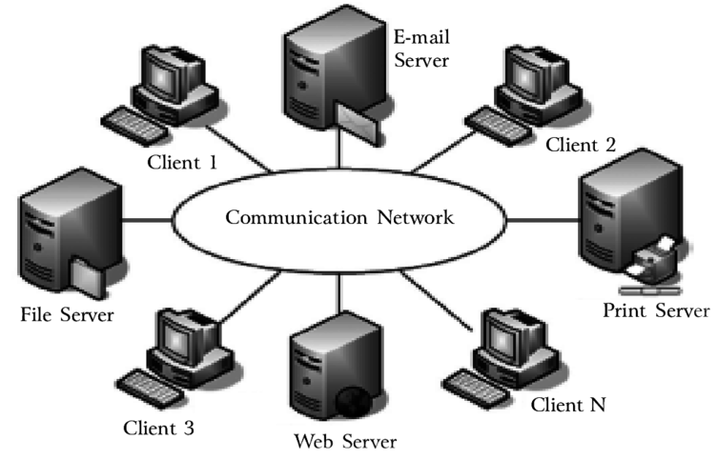
Introduction to computer networks
A network is a set of devices (often referred to as nodes) connected by communication links in such a way that they can share resources.
“Computer network’’ to mean a collection of autonomous computers interconnected by a single technology.
The connection need not be via a copper wire; fiber optics, microwaves, infrared, and communication satellites can also be used.
Networks of different sizes, shapes and forms connected together to make a larger network called internet.
A resource may be:
A file
A folder
A printer
A disk drive

Slide 4
computer networks
Advantages:
Connectivity and Communication
Data Sharing
Hardware Sharing
Increasing storage capacity
Internet Access
Internet Access Sharing
Data Security and Management
Performance Enhancement and Balancing
Entertainment
E-commerce
Disadvantages:
Network Hardware, Software and Setup Costs
Hardware and Software Management and Administration Costs
Undesirable Sharing
Illegal or Undesirable Behavior
Data Security Concerns

Slide 5
Open System Interconnection (OSI) Reference Model
OSI stands for Open Systems Interconnection
Created by International Standards Organization (ISO)
Was created as a framework and reference model to explain how different networking technologies work together and interact
It is not a standard that networking protocols must follow
Each layer has specific functions it is responsible for
All layers work together in the correct order to move data around a network
In its most basic form, it divides network architecture into seven layers which, from top to bottom, are the Application, Presentation, Session, Transport, Network, Data-Link, and Physical Layers.

Slide 6
OSI Reference Model
Data
APPLICATION
Application to Application
APPLICATION
Data
PRESENTATION
Application to Application
PRESENTATION
Data
SESSION
Application to Application
SESSION
Segment
TRANSPORT
Process to Process
TRANSPORT
Packet
NETWORK
Source to Destination
NETWORK
Router
Source to Destination
Frame
DATA LINK
Hop to Hop
Switch
DATA LINK
Hop to Hop
Bits
Hub and Repeater
PHYSICAL
PHYSICAL
Physical Medium

Slide 7

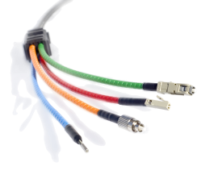
OSI Reference Model
Physical layer:
Deals with all aspects of physically moving data from one computer to the next.
Converts data from the upper layers into 1s and 0s for transmission over media.
Defines how data is encoded onto the media to transmit the data
Defined on this layer: Cable standards, wireless standards, and fiber optic standards.
Copper wiring, fiber optic cable, radio frequencies, anything that can be used to transmit data is defined on the Physical layer of the OSI Model
Device example: Hub-connects multiple PCs to a network.
Used to transmit data

Slide 8
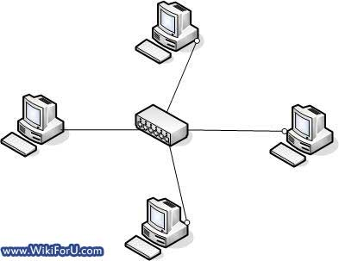
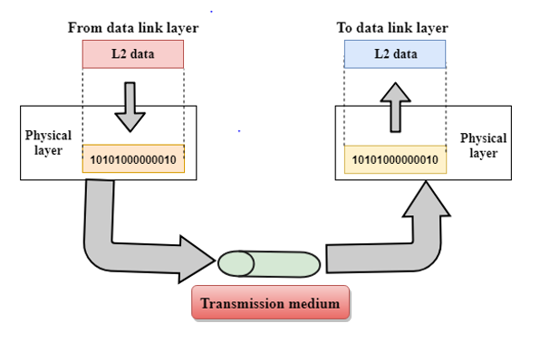
OSI Reference Model
Physical layer: Concerned
Physical characteristics of interface and medium (Transmission medium)
Representation of bits (stream of bits (0s or 1s) with no interpretation and encoded into signals) Data rate (duration of a bit, which is how long it last)
Synchronization of bits (sender and receivers clock must be synchronized), Line configuration (Point-to-Point, Point-to-Multipoint)
Physical topology
Transmission mode (Simplex, half duplex, full duplex)

Slide 9
OSI Reference Model
Data link layer: (Host to Host)
Is responsible for moving frames from node to node or computer to computer
Can move frames from one adjacent computer to another, cannot move frames across routers
Encapsulation = frame
Requires MAC address or physical address
Protocols defined include Ethernet Protocol and Point-to-Point Protocol (PPP)
Device example: Switch-connects multiple devices to a network.
Two sublayers: Logical Link Control (LLC) and the Media Access Control (MAC)
Logical Link Control (LLC): Data Link layer addressing, flow control, address notification, error control

Slide 10
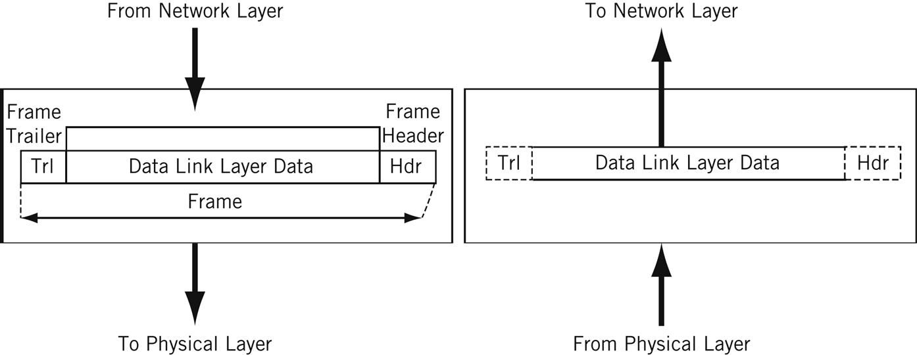
OSI Reference Model
Framing (stream of bits into manageable data units) Physical addressing (MAC Address)
Flow Control (mechanism for overwhelming the receiver) Error Control (trailer, retransmission)
Access Control (defining master device in the same link)
Media Access Control (MAC): Determines which computer has access to the network media at any given time
Determines where one frame ends and the next one starts, called frame synchronization
Concerned:

Slide 11
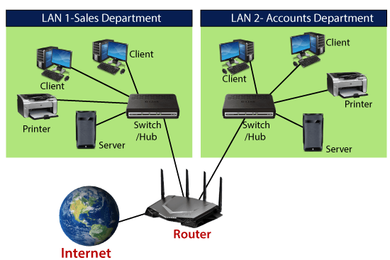
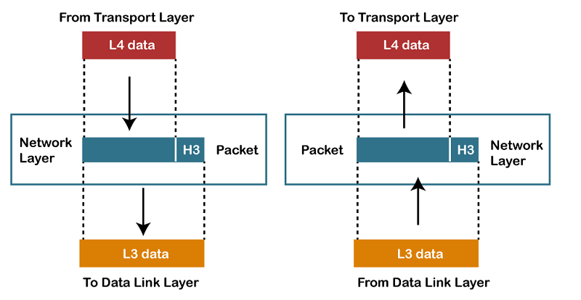
OSI Reference Model
Network layer: (Source to Destination)
Responsible for moving packets (data) from one end (source host) of the network to the other (destination host), called end-to-end communications
Requires logical addresses such as IP addresses
Device example: Router-connect 2 or more packet switching networks
Routing is the ability of various network devices and their related software to move data packets from source to destination
Concerned: Logical addressing (IP Address)
Routing (Source to destination transmission between networks)

Slide 12
OSI Reference Model
Transport layer: (Process to Process)
Takes data from higher levels of OSI Model and breaks it into segments that can be sent to lower-level layers for data transmission
Conversely, reassembles data segments into data that higher-level protocols and applications can use
Also puts segments in correct order (called sequencing) so they can be reassembled in correct order at destination
Concerned with the reliability of the transport of sent data
May use a connection-oriented protocol such as TCP to ensure destination received segments
May use a connectionless protocol such as user datagram protocol (UDP) to send segments without assurance of delivery
Uses port addressing

Slide 13
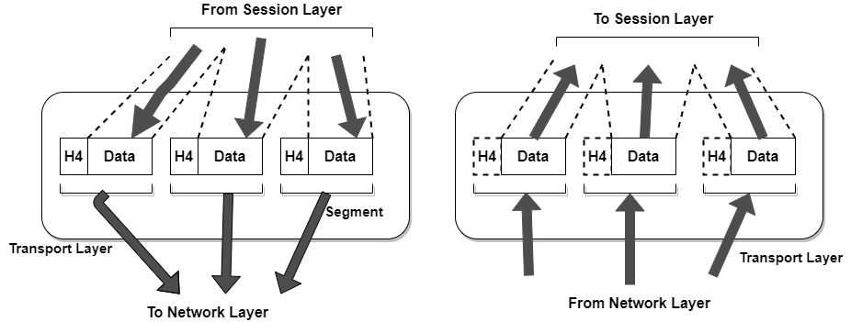
OSI Reference Model
Transport layer: Concerned
Service-point addressing (Port address)
Segmentation and reassembly (Sequence number)
Connection control (Connectionless or connection oriented) Flow control (end to end)
Error Control (Process to Process)

Slide 14
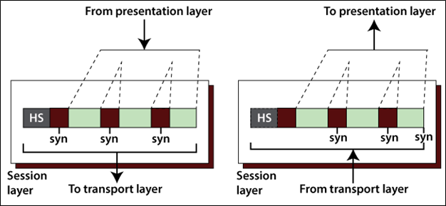
OSI Reference Model
Session layer:
Responsible for managing the dialog between networked devices
Establishes, manages, and terminates connections
Provides duplex, half-duplex, or simplex communications between devices
Provides procedures for establishing checkpoints, adjournment, termination, and restart or recovery procedures
Concerned:
Dialog Control (Half Duplex/Full duplex)
Synchronization (Synchronization points, process inline within same page)

Slide 15
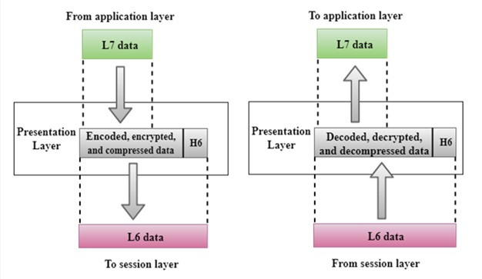
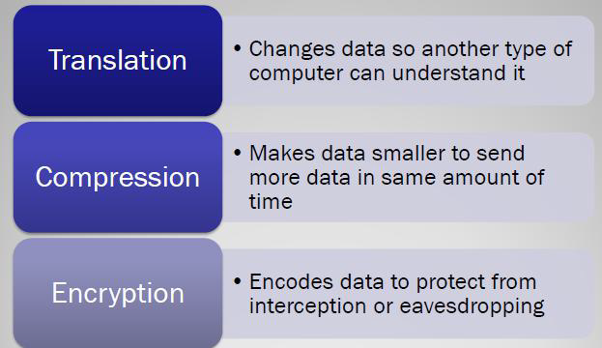
OSI Reference Model
Presentation layer:
Concerned with how data is presented to the network
Handles three primary tasks: –Translation , –Compression , –Encryption
Concerned:
Translation (interoperability between different encoding system) Encryption (Privacy schemes)
Compression (data compression)

Slide 16
OSI Reference Model
Application layer:
Responsible for providing services to user
Contains all services or protocols needed by application software or operating system to communicate on the network
Examples o –Firefox web browser uses HTTP (Hyper-Text Transport Protocol) o –E-mail program may use POP3 (Post Office Protocol version 3) to read e-mails and SMTP (Simple Mail Transport Protocol) to send e-mails
Concerned:
Network virtual terminal (Software), File transfer, access and management, Mail services
Directory services (access to distributed database sources for global information about various objects and services)

Slide 17
OSI Reference Model

Slide 18
Types of Networks
Local Area Network
Wide Area Network
Metropolitan Area Network
Campus/Corporate Area Network
Personal Area Network
Peer-to-Peer Networks

Slide 19
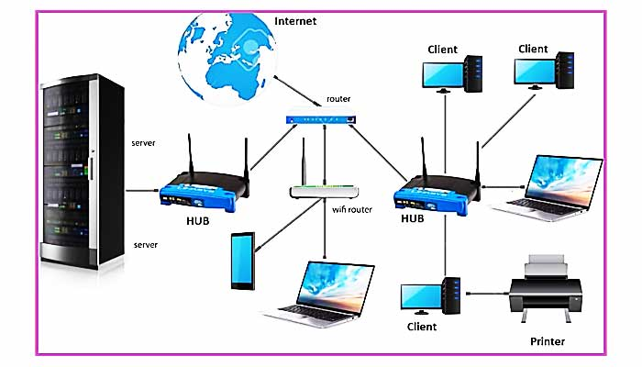
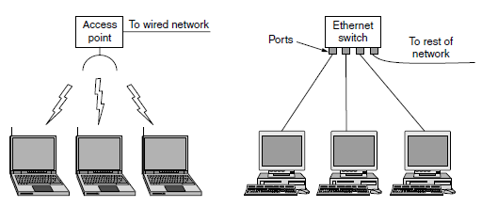
Local Area Network
A local area network (LAN) is a computer network covering a small geographic area, like a home, office, or group of buildings
Most LANs connect to the Internet at a central point: a router. Home LANs often use a single router, while LANs in larger spaces may additionally use network switches for more efficient packet delivery.
LANs almost always use Ethernet, WiFi, or both in order to connect devices within the network. Ethernet is a protocol for physical network connections that requires the use of Ethernet cables. WiFi is a protocol for connecting to a network via radio waves.

Slide 20
Local Area Network
A variety of devices can connect to LANs, including servers, desktop computers, laptops, printers, IoT devices, and even game consoles. In offices, LANs are often used to provide shared access to internal employees to connected printers or servers.
Speed up to 10Gbps.
Topology is point-to-point links using a SWITCH that relays packets between the computers.
Dividing LAN into small logical LANs useful to broadcast and restrict the packets between different departments of users.
Service allocation- Static allocation: time allocation and round robin algorithm- lost in channel capacity.
Dynamic allocation: 2 ways- Centralized and Decentralized
Centralized: base station prioritize and allocates the channel.
Decentralized: each system must decide itself whether to transmit- chaos handled by different algorithms.

Slide 21
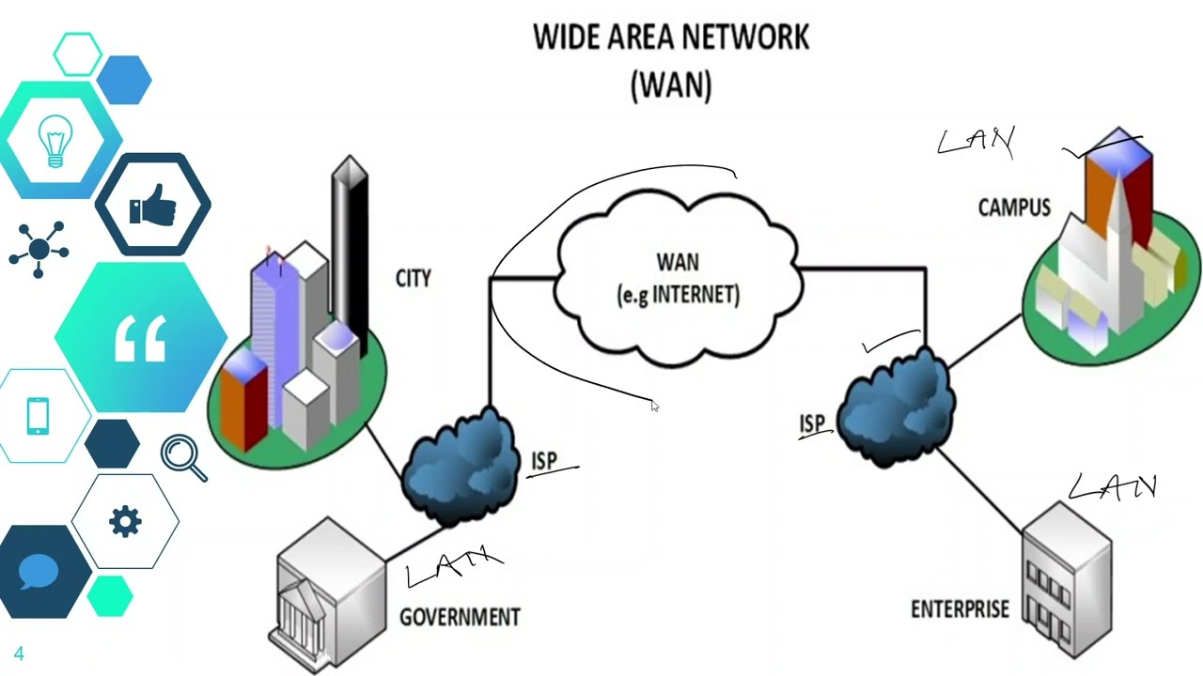
Wide Area Network
Wide Area Network (WAN) is a computer network that covers a broad area (i.e., any network whose communications links cross metropolitan, regional, or national boundaries). Or, less formally, a network that uses routers and public communications links
The largest and most well-known example of a WAN is the Internet.
WANs are used to connect LANs and other types of networks together, so that users and computers in one location can communicate with users and computers in other locations

Slide 22
Wide Area Network
Each computer is a host and the network of these hosts is a subnet in WAN.
2 distinct components in the subnet: Transmission lines and switching elements.
Transmission lines move bits between computers and switches has two or more transmission lines.
Routing algorithm in the network make decisions to select paths between two routers.
Forwarding algorithm in each router decides where to send the packet.
Examples of WAN:
Satellite systems
Cellular telephone networks

Slide 23
Wide Area Network
Varieties of WAN:
Virtual private network (VPN)- virtualization and flexible usage of resources.
Network service provider/ internet service provider handling a subnet.
Differences with LAN:
Hosts and subnets in WAN are owned and operated by different people.
Routers connect different kinds of networking technology.
Subnet could be individual computers connected to LANs or the entire LANs.

Slide 24
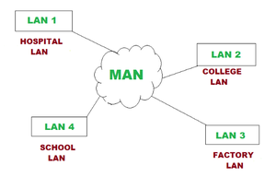
Metropolitan Area Network
A metropolitan area network (MAN) is a network that interconnects users with computer resources in a geographic area or region larger than that covered by even a large local area network (LAN) but smaller than the area covered by a wide area network (WAN).
The term is applied to the interconnection of networks in a city into a single larger network (which may then also offer efficient connection to a wide area network).
It is also used to mean the interconnection of several local area networks by bridging them with backbone lines. The latter usage is also sometimes referred to as a campus network.
Eg. Cable television networks, WiMax.

Slide 25
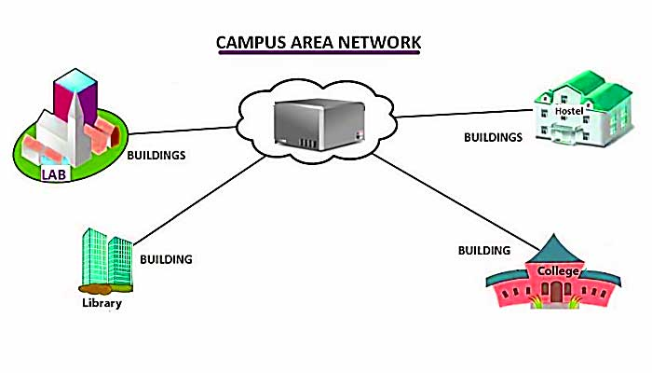
Campus or Corporate Area Network
A campus area network (CAN) is a computer network that spans a limited geographic area. CANs interconnect multiple local area networks (LAN) within an educational or corporate campus. Most CANs connect to the public Internet.
Parent organization owns and operates all the networking equipment and infrastructure.
Typically manages by internal IT team.

Slide 26
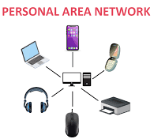
Personal Area Network
A personal area network (PAN) connects electronic devices within a user's immediate area. The size of a PAN ranges from a few centimeters to a few meters. One of the most common real-world examples of a PAN is the connection between a Bluetooth earpiece and a smart phone. PANs can also connect laptops, tablets, printers, keyboards, and other computerized devices.
The master (PC) tells the slaves what addresses to use, when they can broadcast, how long they can transmit, what frequencies they can use, and so on.
Eg: Bluetooth devices, pacemaker, insulin pump, or hearing aid talks to a user-operated remote control.

Slide 27
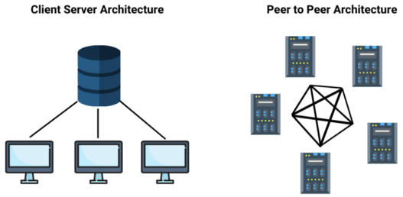
Peer to Peer Network
A peer-to-peer network is a network where the computers act as both workstations and servers.
Great for small, simple, and inexpensive networks.
In a strict peer-to-peer networking setup, every computer is an equal; a peer in the network.
Each machine can have resources that are shared with any other machine.
There is no assigned role for any particular device, and each of the devices usually runs similar software. Any device can and will send requests to any other.

Slide 28
Network Metrics
Network metrics are qualitative and quantitative ways to observe and determine network behavior.
Network performance monitoring tools are designed to deliver out-of-the-box visibility into network availability and performance metrics.
They’re also designed to be fast, lightweight, and easy to use.
Alerts and get real-time notifications for outages and potential errors to monitor network metrics and minimize downtime and fix network failures.
Also able to monitor and track network bandwidth, network configurations. The network metrics are
Downloading
Uploading
Buffering
Speed- Baud rate
Bandwidth

Slide 29

Network Metrics
Downloading:
In computer networks, download means to receive data from a remote system, typically a server such as a web server, an FTP server, an email server, or other similar system.
It generally transfers entire files for local storage and later use.
streaming, where the data is used nearly immediately, while the transmission is still in progress, and which may not be stored long-term. – restrictions on the data.
Require more network bandwidth for both download and streaming.

Slide 30

Network Metrics
Uploading:
Uploading refers to transmitting data from one computer system to another through means of a network.
Eg: uploading via web browsers, social media, emails etc.
Uploading can be used in the context of (potentially many) clients that send files to a central server.
Uploading can also be defined in the context of sending files between distributed clients, such as with a peer-to-peer (P2P) file-sharing protocol like BitTorrent, the term file sharing is more often used in this case.
Moving files within a computer system, as opposed to over a network, is called file copying.
Uploading directly contrasts with downloading.
Uploading is often slower than downloading as many internet service providers (ISPs) offer asymmetric connections, which offer more network bandwidth for downloading than uploading.

Slide 31

Network Metrics
Buffering:
Buffering refers to the process of temporarily storing data in memory (a buffer) before it is sent or received over a network.
The buffer helps to smooth out any variations in the rate at which data can be sent or received, and ensures that the sender and receiver can work at their own pace without interruption.
Eg: when streaming a video, the video player may buffer some of the video before it starts playing. This is done so that if the network connection is slow, the video can continue playing without interruption.
Similarly, buffering before sending the data to prevent the network from becoming overloaded.
Need:
Speed mismatches
Network handling
Error handling
Synchronization
User experience
Power optimization
Ensure data integrity

Slide 32
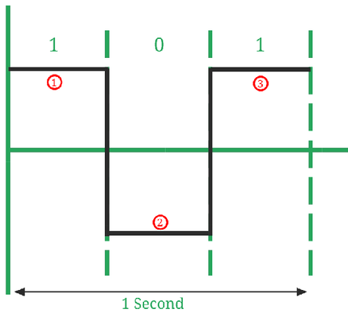
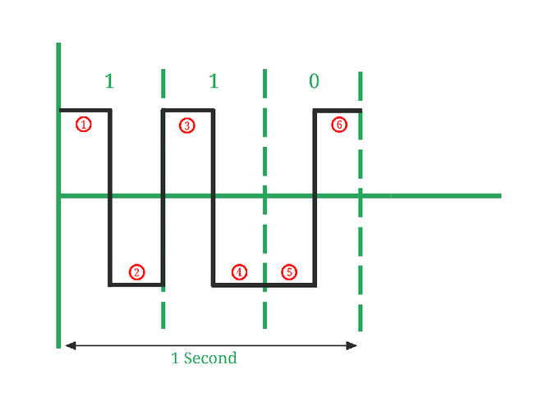
Network Metrics
Speed-baud rate:
In a digitally modulated signal or a line code, symbol rate, modulation rate or baud rate is the number of symbol changes, waveform changes, or signaling events across the transmission medium per unit of time.
The symbol rate is measured in baud (Bd) or symbols per second.
In the case of a line code, the symbol rate is the pulse rate in pulses per second. Each symbol can represent or convey one or several bits of data. The symbol rate is related to the gross bit rate, expressed in bits per second.
Bit rate = number of bits transmitted/ total time (in seconds)
Baud rate = number of signal elements/total time (in seconds)
Bit rate=3
Baud rate=3
Bit rate=3
Baud rate=6

Slide 33
Network Metrics
Speed-baud rate: Importance
Baud rate can determine the bandwidth requirements for transmission of the signal.
Baud rate is also used for the calculation of the Bit rate of a communication channel. Bit rate = Baud rate x bits per signal or symbol
It is a tuning parameter (i.e., it adjusts the Network congestion in data networking) for the transmission of a signal.
It specifies how fast data can be sent over a serial line or serial interface (it’s an interface that sends data as a series of bits over a single wire.).

Slide 34
Network Metrics
Bandwidth:
Network bandwidth is a measure of the data transfer rate or capacity of a given network. It’s a crucial network measurement for understanding the speed and quality of a network.
Network bandwidth is commonly measured in bits per second (bps). In practice, organizations and internet service providers (ISPs) measure bandwidth in megabits per second (Mbps) or gigabits per second (Gbps).
Bandwidth is essential parameter of physical layer.

Slide 35
Wired and Wireless Media
Wired Media:
Twisted-pair Wires
Coaxial Cables
Fiber Optic Cables
5G- technologies
Wireless Media:
Terrestrial Microwaves
Satellite Communication
Infrared Communication

Slide 36
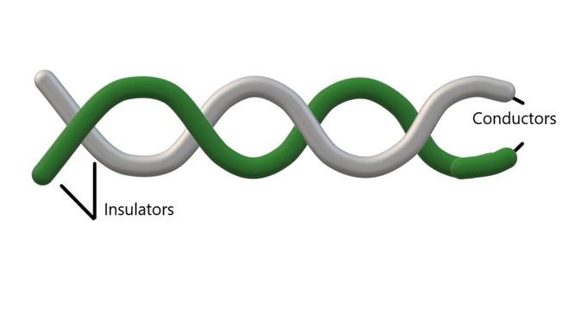
Twisted Pair Wires
One of the oldest and still most common transmission media is twisted pair often used to carry voice as well as data communications
Low frequency transmission medium
A twisted pair consists of two insulated copper wires twisted together in helical shape like a DNA model, typically about 1 mm thick.
Parallel wires work as antenna, twisting cancels waves at different twists and radiates less effectively.
Signal carried as difference in voltage in between these two wires, provides better immunity to noise.
More the number of twists per meter, less the crosstalk and more data rates (up to 1Gbps LAN cable).

Slide 37
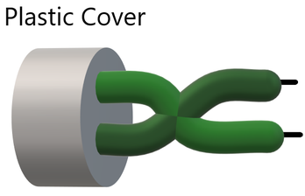
Twisted Pair Wires
UTP (unshielded twisted pair)
Each wire is insulated with plastic wrap, but the pair is encased in an outer covering.
Insulation reduces external interference
DSL or telephone lines in our houses have one extra pair in them
Advantages:
Compact size, cost effective, easy to install
Voice and data over short distance
Disadvantages:
Insecure connection
Efficient for shorter distances <100m.
Limited bandwidth

Slide 38
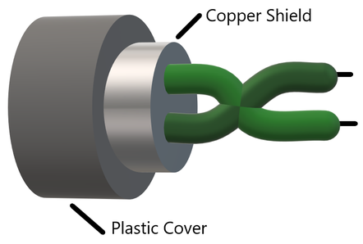
Twisted Pair Wires
STP (shielded twisted pair)
Extra insulation or protective covering over the conductors in the form of a copper braid covering.
Covering provides extra strength, reduces noise and interference.
Costly and difficult to install
Advantages:
Long distance communication, transmission
Installed underground
Higher bandwidth compared to UTP
Prevents EM interference
Disadvantages:
Expensive
High maintenance
Underground installation only

Slide 39
Twisted Pair Wires
Applications:
Telephone lines to provide data and voice channels.
The DSL lines make use of these cables.
Local Area Networks (LAN) also make use of twisted pair cables.
Used for both analog and digital transmission.
RJ-45 is a very common application of twisted pair cables
Disadvantages:
Susceptibility to interference and noise
Attenuation problem
For analog, repeaters needed every 5-6km
For digital, repeaters needed every 2-3km
Relatively low bandwidth (3000Hz)

Slide 40
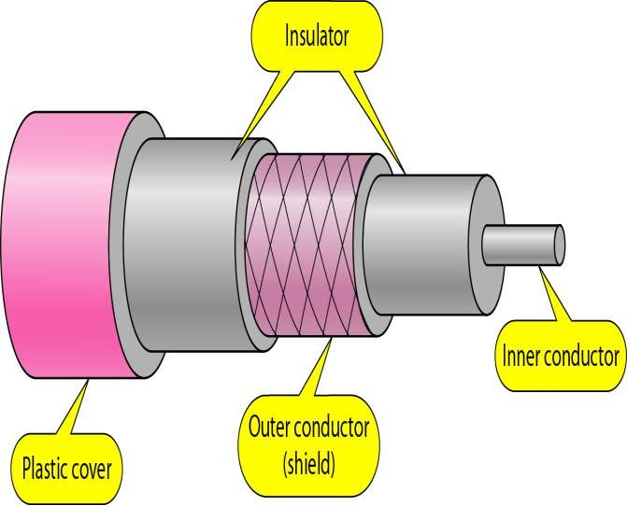
Coaxial cables
Has an inner conductor surrounded by a braided mesh
Both conductors share a common center axial, hence the term “co-axial”
Better shielding and greater bandwidths, longer distances at high speed
Used for cable television, LANs, MANs and telephony.
A coaxial cable consists of a stiff copper wire as the core, surrounded by an insulating material.
The insulator is encased by a cylindrical conductor, often as a closely woven braided mesh.
The outer conductor is covered in a protective plastic sheath.
Bandwidths up to few GHz.

Slide 41
Coaxial cables
Advantages
Higher bandwidth
– 400 to 600Mhz
– up to 10,800 voice conversations
Can be tapped easily (pros and cons)
Much less susceptible to interference than twisted pair
Disadvantages
High attenuation rate makes it expensive over long distance
Bulky

Slide 42
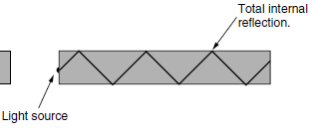
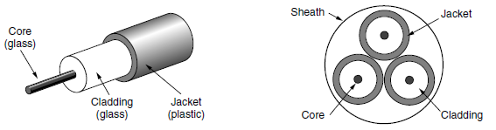
Fiber optic cable
Fiber optic cables are similar to coax, except without the braid.
The center is the glass core through which the light propagates.
The core is surrounded by a glass cladding with a lower index of refraction than the core, to keep all the light in the core.
Next comes a thin plastic jacket to protect the cladding.
Light source, transmission medium and the detector are key components.
A light ray incident at or above the critical angle is trapped inside the fiber.
LED or semiconductor lasers act as light source and photodiode at the receiving side gives off electrical pulse when struck by light.

Slide 43
Fiber optic cable
In multimode fibers (multiple light rays with different modes reflecting at different lengths), the core is typically 50 microns in diameter, about the thickness of a human hair.
In single-mode fibers (light transmits in a straight line), the core is 8 to 10 microns-few wavelengths of light.
Terrestrial sheaths and deep water sheaths establish wide area and intercontinental network.
Advantages:
higher bandwidths
Low attenuation
Immune to power surges, EMI & power failures
Immune to corrosive chemicals
Thin and light weight
Easy to install
Do not leak light and difficult to tap

Slide 44
Fiber optic cable
Disadvantages:
Skill requirement
Damages at bends
Unidirectional transmission: require two fibers or two frequency bands in one fiber for two way communication
Interface cost is high

Slide 45
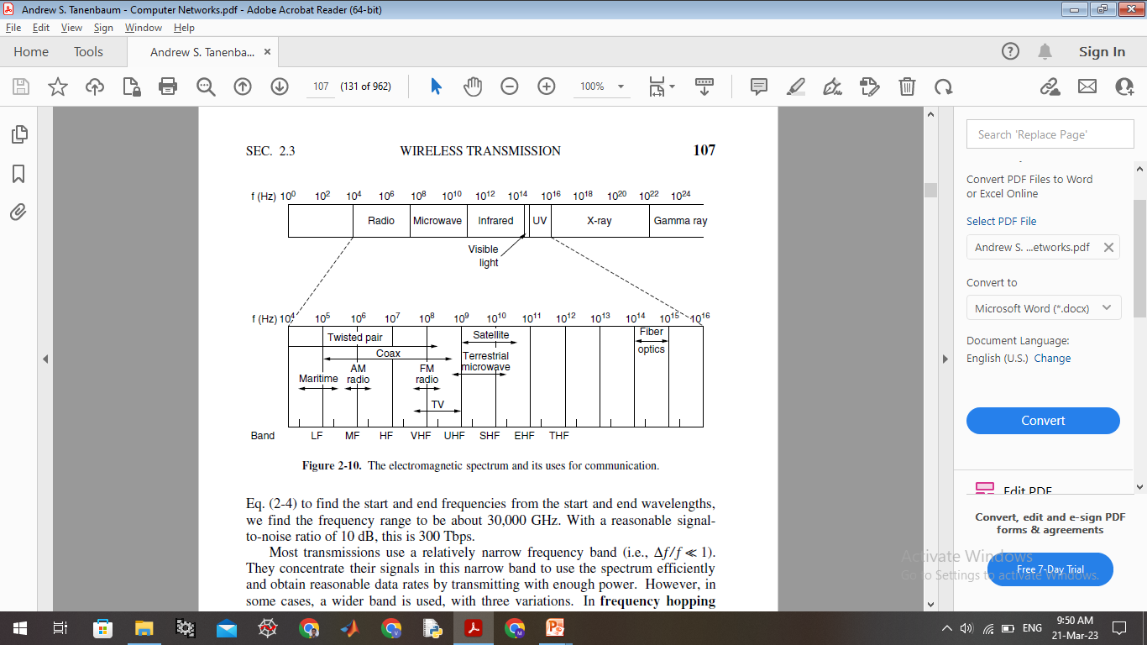
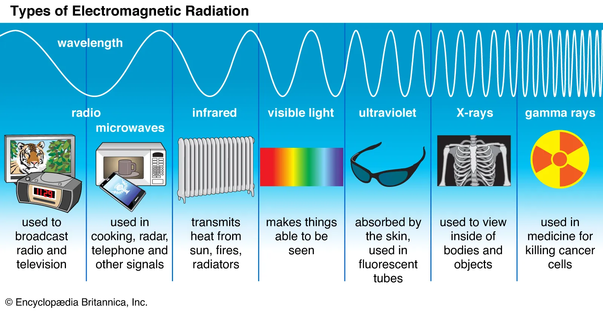
Wireless Media
The EM spectrum

Slide 46
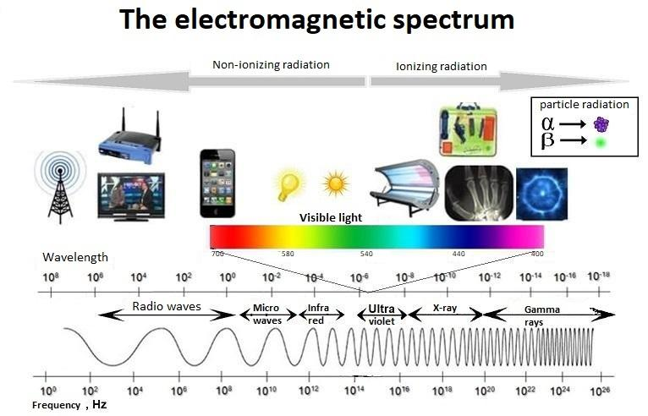
Wireless Media
The EM spectrum

Slide 47
Terrestrial Microwaves
Terrestrial communication follows two ways. 1. Radio, 2. Microwave
Radio frequency (3KHz to 1GHz) waves are easy to generate, travel long distances, penetrate through walls.
Highly regulated. Use Omni directional antennas
Transmission and reception are achieved by means of an antenna
Radio waves are frequency dependent- low frequency waves penetrate through walls but power falls sharply with the distance-path loss
High frequency waves travel in straight lines and bounce off obstacles- Reflections are key- path loss still exist- absorbed by rain and other obstacles.
Interference from motors and other e-gadgets effect RF waves.
Compared to twisted pair and fiber optics, signal drops by same amount for double the distance.
VLF, LF, and MF follow ground- ranges up to 1000km at lower frequencies and less at higher frequencies.
MF band for AM radio services. For data transmission, bandwidth is a constraint.

Slide 48
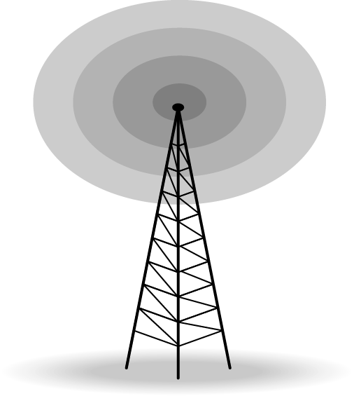
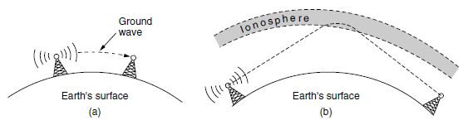
Terrestrial Microwaves
HF and VHF tend to absorbed by earth, refractions from ionosphere (100-500km above earth surface) provide long distance communication – amateur radio and military communications.
The antennas of two types:
Directional
transmitting antenna puts out focused beam
transmitter and receiver must be aligned
omnidirectional
signal spreads out in all directions
can be received by many antennas

Slide 49
Terrestrial Microwaves
Microwaves (>100MHz) travel in nearly straight lines, narrowly focused.
A parabolic antenna concentrating energy into a small beam- transmitting and receiving antennas should be properly aligned.
Directionality allows multiple transmitters communicate with multiple receivers without interference- with spacing constraints.
For 100m height tower, repeaters can be at 80km apart.
Microwaves do not pass through buildings.
Low-lying atmospheric layers cause refractions and cause delays in the waves at receiver, these delayed signals form multipath fading.
Bands up to 10GHz are in use, but about 4GHz waves absorbed by water.
Used in long-distance telephone communication, mobile phones and television distribution etc.
Governments regulate over allocation of bandwidths for telephone and data transmission services

Slide 50
Terrestrial Microwaves
Higher frequency bands around 60GHz are in demand, technologies are advancing toward that.
These bands provide high data rate- HD TV streaming-in short range networks- absorbed by oxygen.
Advantage over guided media:
Small area for tower than entire operating station
Inexpensive compared to optical fiber costs

Slide 51
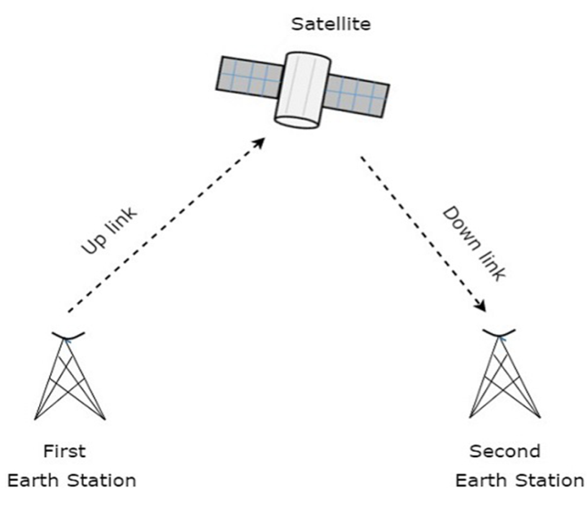
Satellite Communications
In general terms, a satellite is a smaller object that revolves around a larger object in space. For example, moon is a natural satellite of earth.
A communication satellite is a big microwave repeater in the sky with multiple transponders-listens signal, amplify, retransmit in another frequency to avoid interference.
The downward beams can be broad, covering a substantial fraction of the earth’s surface, or narrow, covering an area only hundreds of kilometers in diameter.
Kepler’s law: orbit period=radius^{(3/2)}
Near earth satellite period: 90 min (Int. Space Station).
At an altitude of about 35,800 km, the period is 24 hours (Eg. IRNSS satellites).
At an altitude of 384,000 km, the period is about one month (Eg. Moon).

Slide 52
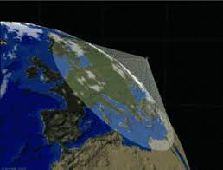
Satellite Communications
Geostationary satellites with multiple transponders with polarization and multiple frequencies increase the available bandwidth.
Lasts 10 or more years till the fuel available and later descend to earth surface.
Uplink is up to 1Mbps, downlink is up to several Mbps.
Require large power to reach them.
Delays in terrestrial microwaves-3 microsec/km, coaxial cables and optical fiber- 5 microsec/km, travel fast in air than in solid materials.
Similar cost for broadcasting for thousands of stations in the foot print and to a single one.
Have excellent error rates to deploy for civilian and military applications.
Cost of message is independent of distance.
Eg: GSAT, ASTROSAT and IRNSS

Slide 53
Satellite Communications
Medium Earth Orbit satellites take 6 hours to circle the earth.
They must be tracked.
Lower than GEO, requires less power to reach.
Eg. GPS satellites at 20,200km.
Low earth orbit satellites take 90mins to circle the earth.
Large number of satellites required for entire system.
Low launch costs, easy to reach and milli seconds of delay in round trip of signal.
Eg. NISAR earth observation satellites and Cartosat <2000km, around 300km.
Advantages over fiber:
Rapid development.
Military and rescue operations
Communication to remote areas
Broadcasting to multiple users

Slide 54
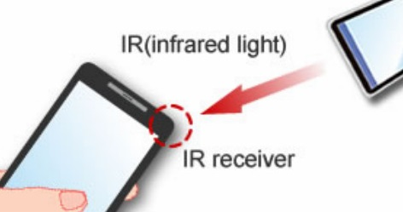
Infrared Communications
Used for short range communications- remote controls, VCS and stereos.
Directional, cheap and easy to build but do not pass through objects.
As we go from long-wave radio toward visible light, the waves behave more and more like light and less and less like radio.
Not interfere with a similar system in adjacent rooms or buildings- increases security.
Used to share few bits of information.

Slide 55
Network Devices
Hub
Repeater
Switch
Bridge
Router
Gateway
Network Interface Card
RJ45

Slide 56
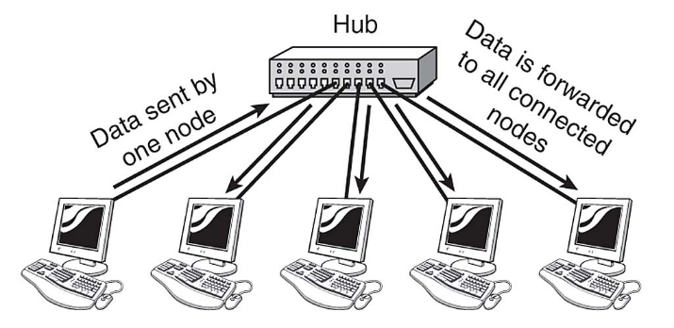
HUB
A hub has a number of input lines that it joins electrically.
Frames arriving on any of the lines are sent out on all the others- listening problem.
All the lines coming into a hub must operate at the same speed.
Hubs differ from repeaters in that they do not (usually) amplify the incoming signals and are designed for multiple input lines, but the differences are slight.
Hubs are physical layer devices that do not examine the link layer addresses or use them in any way.
Hubs cannot provide routing capabilities or other advanced network services.
Referred to as "dumb switches."

Slide 57
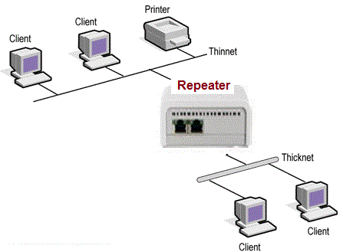
Repeater
Exist in the physical layer.
These are analog devices that work with signals on the cables to which they are connected.
A signal appearing on one cable is cleaned up, amplified, and put out on another cable.
Repeaters do not understand frames, packets, or headers. They understand the symbols that encode bits as volts.
Classic Ethernet, for example, was designed to allow four repeaters that would boost the signal to extend the maximum cable length from 500 meters to 2500 meters.

Slide 58
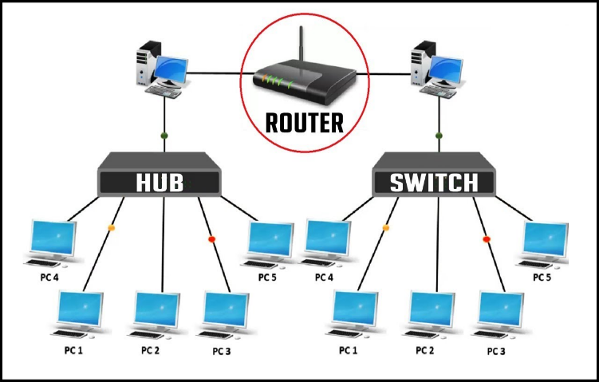
Switch
Switches are active devices, has many ports and at data link layer (layer2),
Use packet switching to send, receive or forward data packets or frames.
Use MAC address to send packets to selected destination ports.
It is supports unicast (one-to-one), multicast (one-to-many) and broadcast (one-to-all) communications, with full duplex channel.
Prevents data collision.
Reduces network congestion.
Increases network performance.

Slide 59
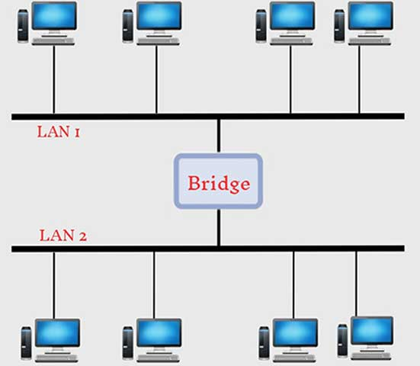
Bridge
Bridges at data link layer (layer2), connect two or more LANs. And forwards or filters data packets between them.
Creates an extended network in which any two workstations on the linked LANs can share data.
Transparent to protocols and to higher level devices like routers.
Forward data depending on the Hardware (MAC) address, not the Network address (IP).
It only outputs the frame on the port where it is needed and can forward multiple frames at the same time.
Better isolation than hubs, supports inputs with different speeds and with different networking techniques.

Slide 60

Router
Router Resides on Layer 3 of the OSI model and connects any number of LANs.
Uses standardized protocols to move packets efficiently to their destination.
More sophisticated than bridges, connecting networks of different types (for example, star and token ring)
Forwards data depending on the Network address (IP), not the Hardware (MAC) address.
Routers are the only one of these four devices that will allow you to share a single IP address among multiple network clients.
The frame header and trailer in a packet are stripped off and the packet located in the frame’s payload field is passed to the routing software.
This software uses the packet header to choose an output line.

Slide 61
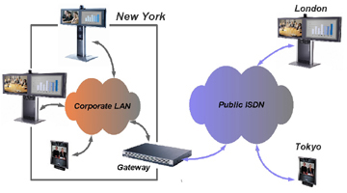
Gateway
Gateway refers to a forwarding process that runs at a high layer.
Transport gateways Present in transport layer and connect two computers that use different connection-oriented transport protocols.
It can copy the packets from one connection to the other, reformatting them as need be.
Finally, application gateways understand the format and contents of the data and can translate messages from one format to another.
An email gateway could translate Internet messages into SMS messages for mobile phones, for example.

Slide 62
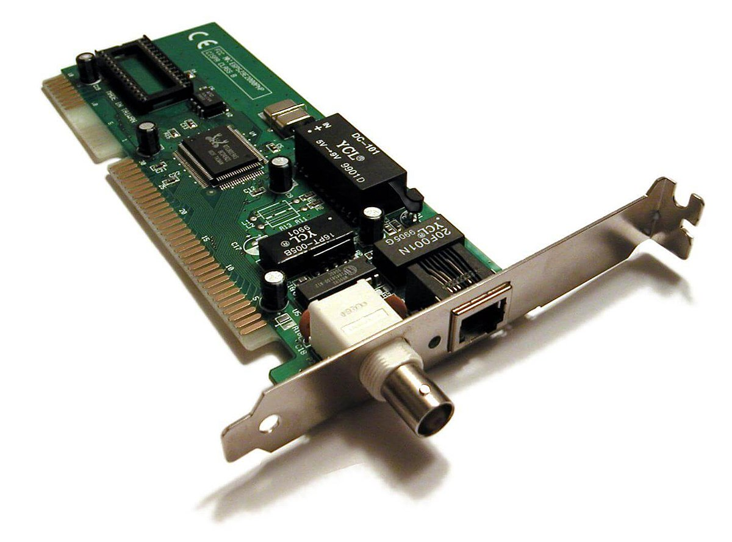
Network Interface Card
It is a circuit board installed in a computer that provides a dedicated network connection to the computer also called LAN adapter.
Provides wired and wireless communications.
It is both physical and data link layer device.
Puts the data into packets and transmits packet onto the network.

Slide 63
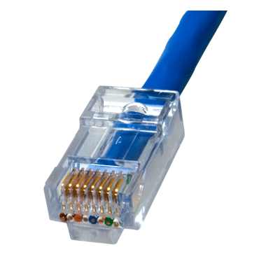
RJ 45
Registered jack-45 (RJ45) is an eight-wire connector used to connect computers on local area networks.
Initially used as a telephone-only standard, but adapted to high-speed modems and other computer networks.

Slide 64
Network Topologies
The arrangement of a network that comprises nodes and connecting lines via sender and receiver is referred to as network topology. The various network topologies are
Bus Topology
Star Topology
Ring Topology
Mesh Topology
Hybrid Topology

Slide 65
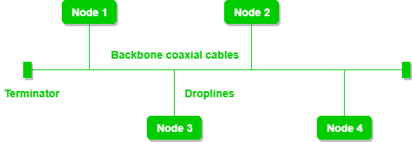
Bus Topology
A bus is the simplest physical topology. It consists of a single cable that runs to every workstation called as backbone.
Uses the least amount of cabling, but also covers the shortest amount of distance.
It is difficult to add a workstation
It is bi-directional.
It is a multi-point connection and a non-robust topology because if the backbone fails the topology crashes.
Eg. Ethernet LAN, where all devices are connected to a single coaxial cable or twisted pair cable and television networks.

Slide 66
Bus Topology
Advantages:
If N devices require 1 cable (backbone), and N drop lines.
Coaxial or twisted pair cables are mainly used-support up to 10 Mbps.
The cost of the cable is less compared to other topologies, but it is used to build small networks.
Familiar technology as installation.
Well known troubleshooting techniques.
Disadvantages:
Simpler, but requires a lot of cabling.
If backbone fails, then the whole system will crash down.
Heavy traffic increases collisions and various protocols used to avoid this.
Adding new devices to the network would slow down networks.
Security is very low.

Slide 67
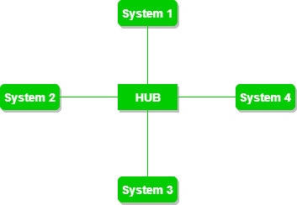
Star Topology
All the devices are connected to a single hub through a cable.
This hub is the central node and all other nodes are connected to the central node.
The hub can be passive in nature i.e., not an intelligent hub such as broadcasting devices, at the same time the hub can be intelligent known as an active hub.
Active hubs have repeaters in them.
Coaxial cables or RJ-45 cables are used to connect the computers.
Eg. LAN in an office and wireless networks.

Slide 68
Star Topology
Advantages:
If N devices require N cables. So, it is easy to set up.
Each device requires only 1 port i.e. to connect to the hub, therefore the total number of ports required is N.
It is Robust. If one link fails only that link will affect and not other than that.
Easy to fault identification and fault isolation.
Star topology is cost-effective as it uses inexpensive coaxial cable.
Disadvantages:
If the concentrator (hub) on which the whole topology relies fails, the whole system will crash down.
The cost of installation is high.
Performance is based on the single concentrator i.e. hub.

Slide 69
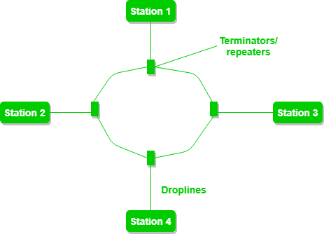
Ring Topology
Forms a ring connecting devices with exactly two neighboring devices.
A number of repeaters are used for a large number of nodes to prevent data loss.
The data flows in one direction (unidirectional), but it can be made bidirectional by having 2 connections between each Network Node, it is called Dual Ring Topology.
In-Ring Topology, the Token Ring Passing protocol is used by the workstations to transmit the data.
Token passing: It is a network access method in which a token is passed from one node to another node.
Token: It is a frame that circulates around the network.
Eg. A small office with only a few nodes.

Slide 70
Ring Topology
Advantages:
High-speed data transmission.
Minimum possibility of collision.
Cheap to install and expand.
It is less costly than a star topology
Disadvantages:
The failure of a single node in the network can cause the entire network to fail.
Troubleshooting is difficult in this topology.
The addition of stations in between or the removal of stations can disturb the whole topology.
Less secure.

Slide 71
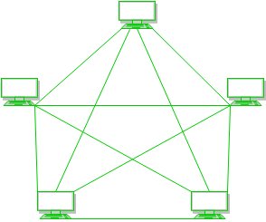
Mesh Topology
Every device is connected to another device via a particular channel.
Simplest in logic but complex in physical design.
N number of devices require N-1 ports for each device. 5 devices require 4 ports for each device.
N number of devices require NC2 i.e. N(N-1)/2 dedicated links. 5 devices require 5*4/2 = 10 dedicated links.
Eg. internet backbone, where various internet service providers are connected to each other via dedicated channels. Also in military communication and aircraft navigation systems

Slide 72
Mesh Topology
Advantages:
Communication is very fast between the nodes.
It is robust.
The fault is diagnosed easily.
Reliable data transmission as it use dedicated channels or links.
Provides security and privacy.
Disadvantages:
Installation and configuration are difficult.
The cost of cables is high as bulk wiring is required, hence suitable for less number of devices.
The cost of maintenance is high.

Slide 73
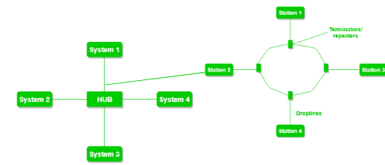
Hybrid Topology
This topological technology is the combination of all the various types of topologies.
It is used when the nodes are free to take any form.
It means these can be individuals such as Ring or Star topology or can be a combination of various types of topologies seen above.
Each individual topology uses the respective protocol.
Eg. University campus network. Star topology as backbone, each building connected to the backbone through a switch or router. Within each building, bus or ring topology connecting the different rooms and offices. The wireless access points also create a mesh topology for wireless devices.
This hybrid topology allows for efficient communication between different buildings while providing flexibility and redundancy within each building.

Slide 74
Hybrid Topology
Advantages:
This topology is very flexible.
The size of the network can be easily expanded by adding new devices.
Disadvantages:
It is challenging to design the architecture of the Hybrid Network.
Hubs used in this topology are very expensive.
The infrastructure cost is very high as a hybrid network requires a lot of cabling and network devices.

